Slide 1

Traffic Accidents
Tazvitya Aubrey Chihota

Slide 2
Table of Contents
The Problem
About the Dataset
Data Preparation
Visualizations
Overall Insights
Recommendations

Slide 3

The Problem
Business Problem
Despite extensive driver‐education requirements and broad road‐safety initiatives, traffic accidents remain concentrated in predictable, high‐risk conditions namely signalized and uncontrolled intersections during clear daylight and end‐of‐week commutes resulting in unnecessary injuries, fatalities, and economic costs.
Current policies, community outreach, and infrastructure programs lack the data‐driven specificity needed to target these common crash scenarios, leaving drivers and road managers without tailored interventions that could substantially reduce crash frequency and severity.
Notes:
Aubrey

Slide 4
About the Data
Dataset:
We used the Traffic Accidents dataset, containing 209,306 records of traffic crashes.
Each row contains a unique crash event with various contributing details.
Structure:
The dataset includes 24 columns, covering factors such as:
Crash timing
Date, Day, Hour
Environmental Conditions
Weather, Lighting, Road Surface)
Injury Outcomes
Total, Fatal, Incapacitating Injuries

Slide 5
Data Preparation
1. Handled Missing or Ambiguous Data
• Replaced all "Unknown" values with Null so that Tableau and other tools could treat them as missing data rather than valid categories
2. Created Indicator Variables
• Introduced dummy variables to flag fatal accidents, helping to isolate and analyze these cases from the full dataset
3. Extracted and Categorized Time Information
• Extracted Crash Hour from the original time format
• Created a new variable Time of Day to group crashes into:
o Morning (6 AM – 12 PM)
o Afternoon (12 PM – 6 PM)
o Evening (6 PM – 12 AM)
o Late Night (12 AM – 6 AM)
4. Filtered and Grouped Weather Conditions – (Fatal Crash Patterns by Time and Weather)
• Limited the analysis to 4 main weather types:
o Clear, Cloudy/Overcast, Rain, and Snow/Ice

Slide 6

How have accidents varied based on conditions present at the time of the accident?

Slide 7
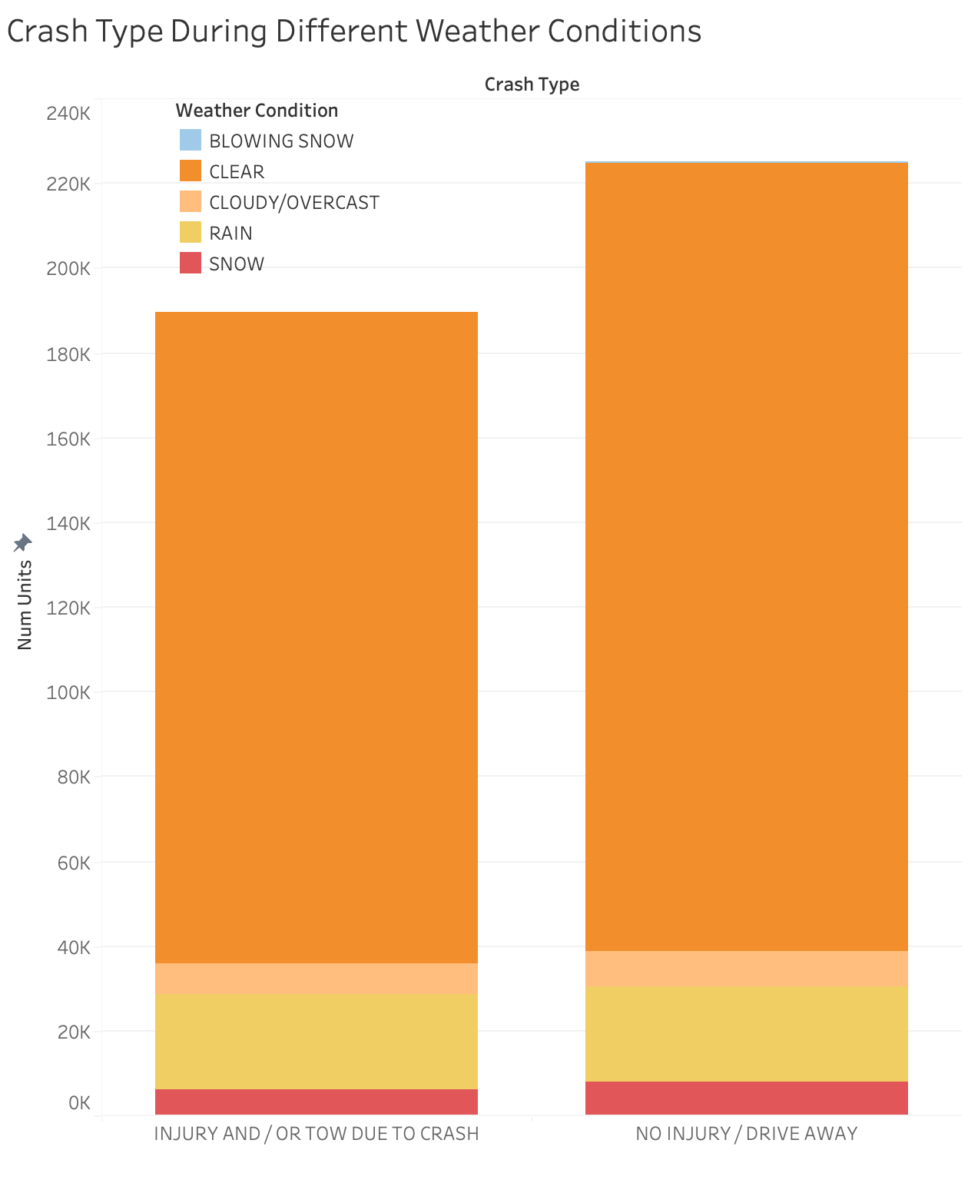
Overall volumes: ~195 000 injury crashes vs. ~238 000 non‑injury crashes.
Clear weather dominates: ~155 000 injury (≈ 80% of injury) and ~190 000 non‑injury crashes (≈ 80% of non‑injury).
Rain is the next most common: ~28 000 injury (14%) and ~43 000 non‑injury (18%) after clear sky accidents.
Crash Type During Different Weather Conditions

Slide 8
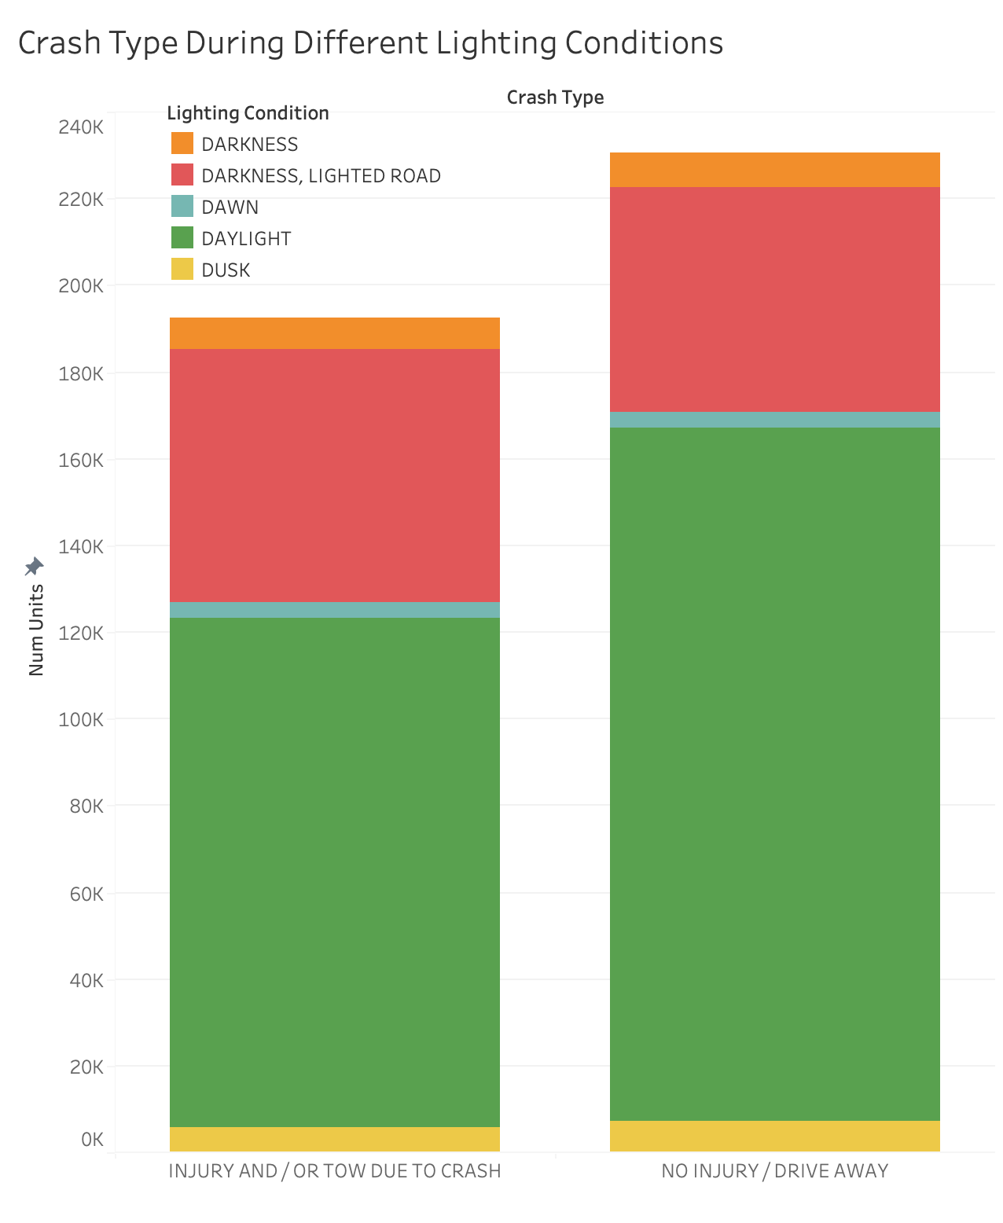
Crash Type During Different Lighting Conditions
Overall volumes match the weather chart: ~195 000 injury vs. ~238 000 non‑injury.
Daylight is by far the highest: ~125 000 injury (64%) and ~175 000 non‑injury (73%).
Darkness, Lighted (i.e. street‑lit): ~60 000 injury (31%) and ~55 000 non‑injury (23%).

Slide 9
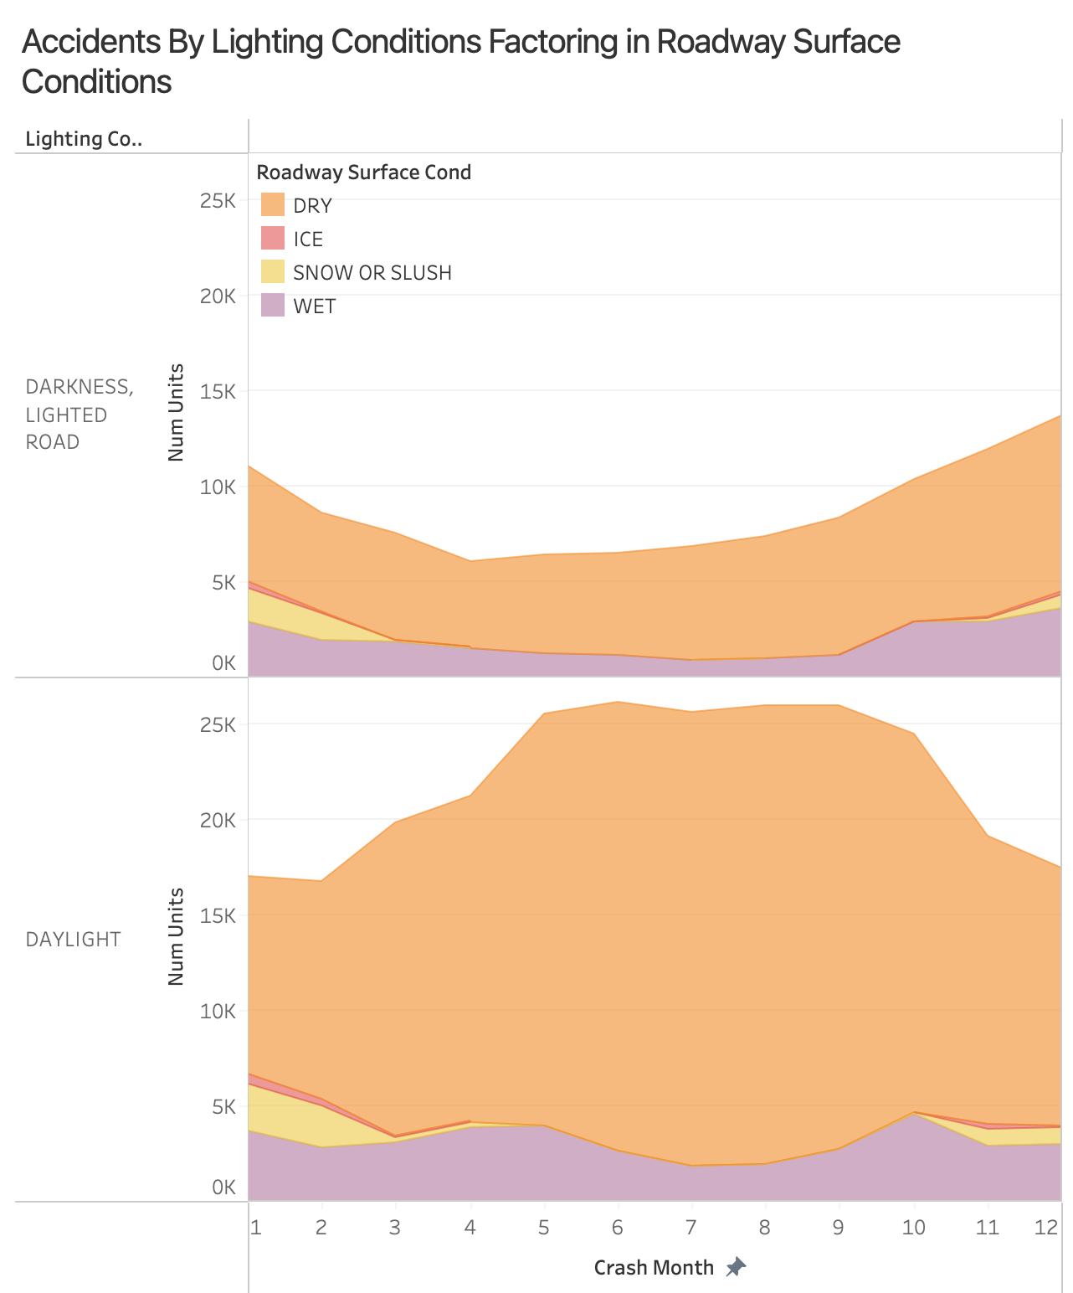
Accidents By Lighting Conditions Factoring in Roadway Surface Conditions
Dry:
Highest Overall
Higher during Spring/Summer Seasons
Ice/Snow/Slush:
Increase appears during earlier and later months in the year
Due to poor road conditions and low visibility
Wet:
Remained Relatively Steady
Notes:
Raise your hand if you typically take drives to the beach or go on road trips during the summer or to amusement parks etc?
That is why you see during the summer period more accidents occur. There are clear skies, the weather is nice, and so more people are typically on the roads during this time resulting in more accidents.
In winter seasons, there is a large increase of crashes in darkness. This can be most likely tied to the limited daylight hours and there being limited visibility especially after work hours.
There is an increase in snow accidents at the beginning and end months, most likely linked to
In summer seasons, there is a large increase in accidents which is possibly linked to an increase of vehicles that are on the road at this time.

Slide 10
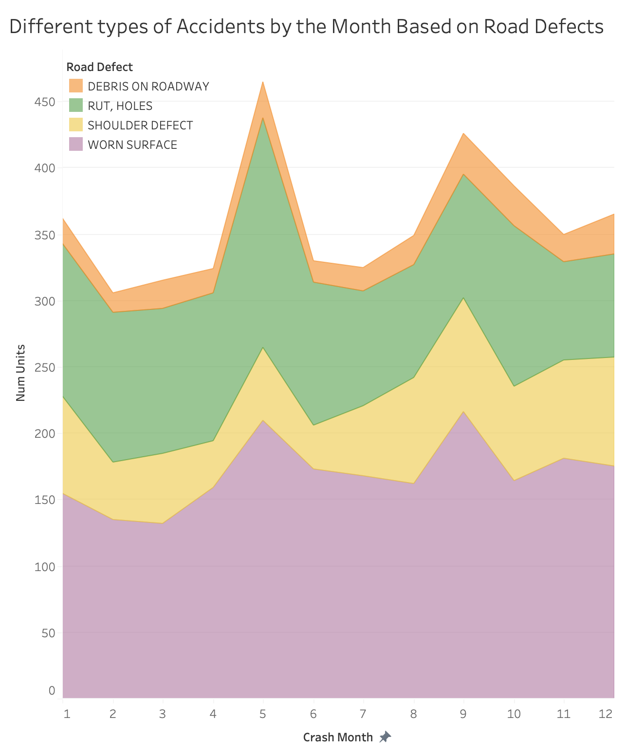
Different types of Accidents Based on Road Defects
Worn Surface:
Dominant contributor to Accidents
Rut and Holes was the second largest accident factor
Shoulder Defects:
Rise during the spring and fall possibly due to weather transitions
Debris on Roadway:
Not a major cause of accidents
Notes:
Debris on Road:
Rut, Holes:
Shoulder Defect:
Worn Surface: Most notable contributor to accidents year round.

Slide 11
When are fatal accidents more prevalent?

Slide 12
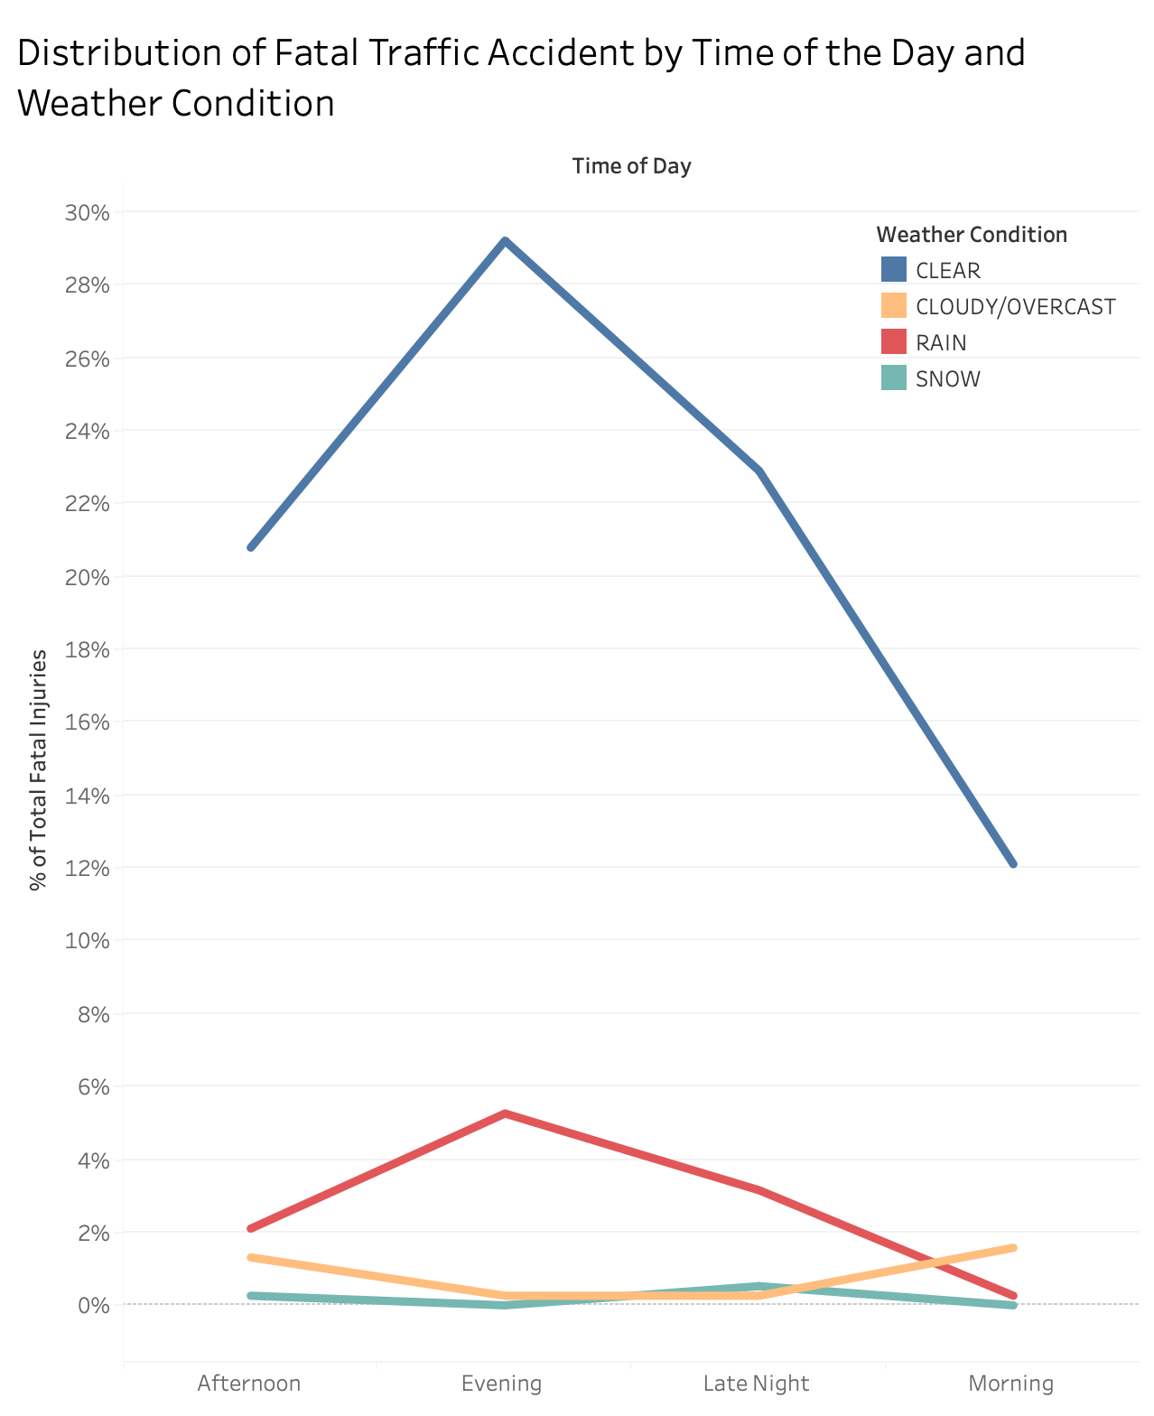
Distribution of Fatal Traffic Accident by Time of the Day and Weather Condition

Slide 13
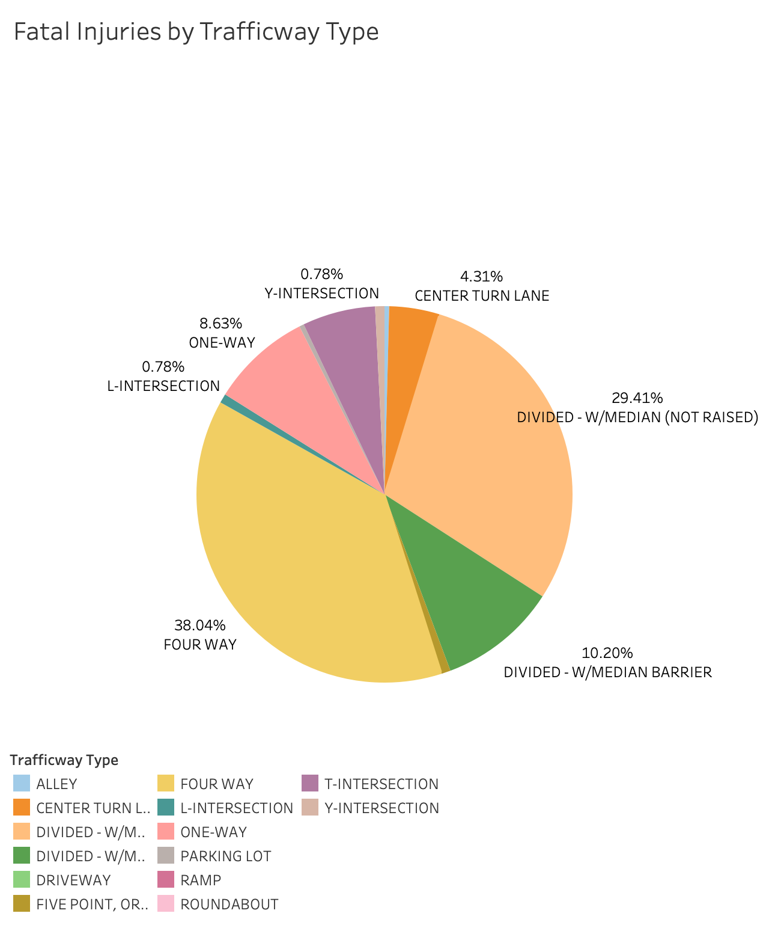
Fatal Injuries by Trafficway Type

Slide 14
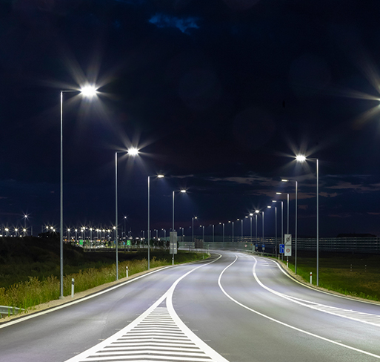
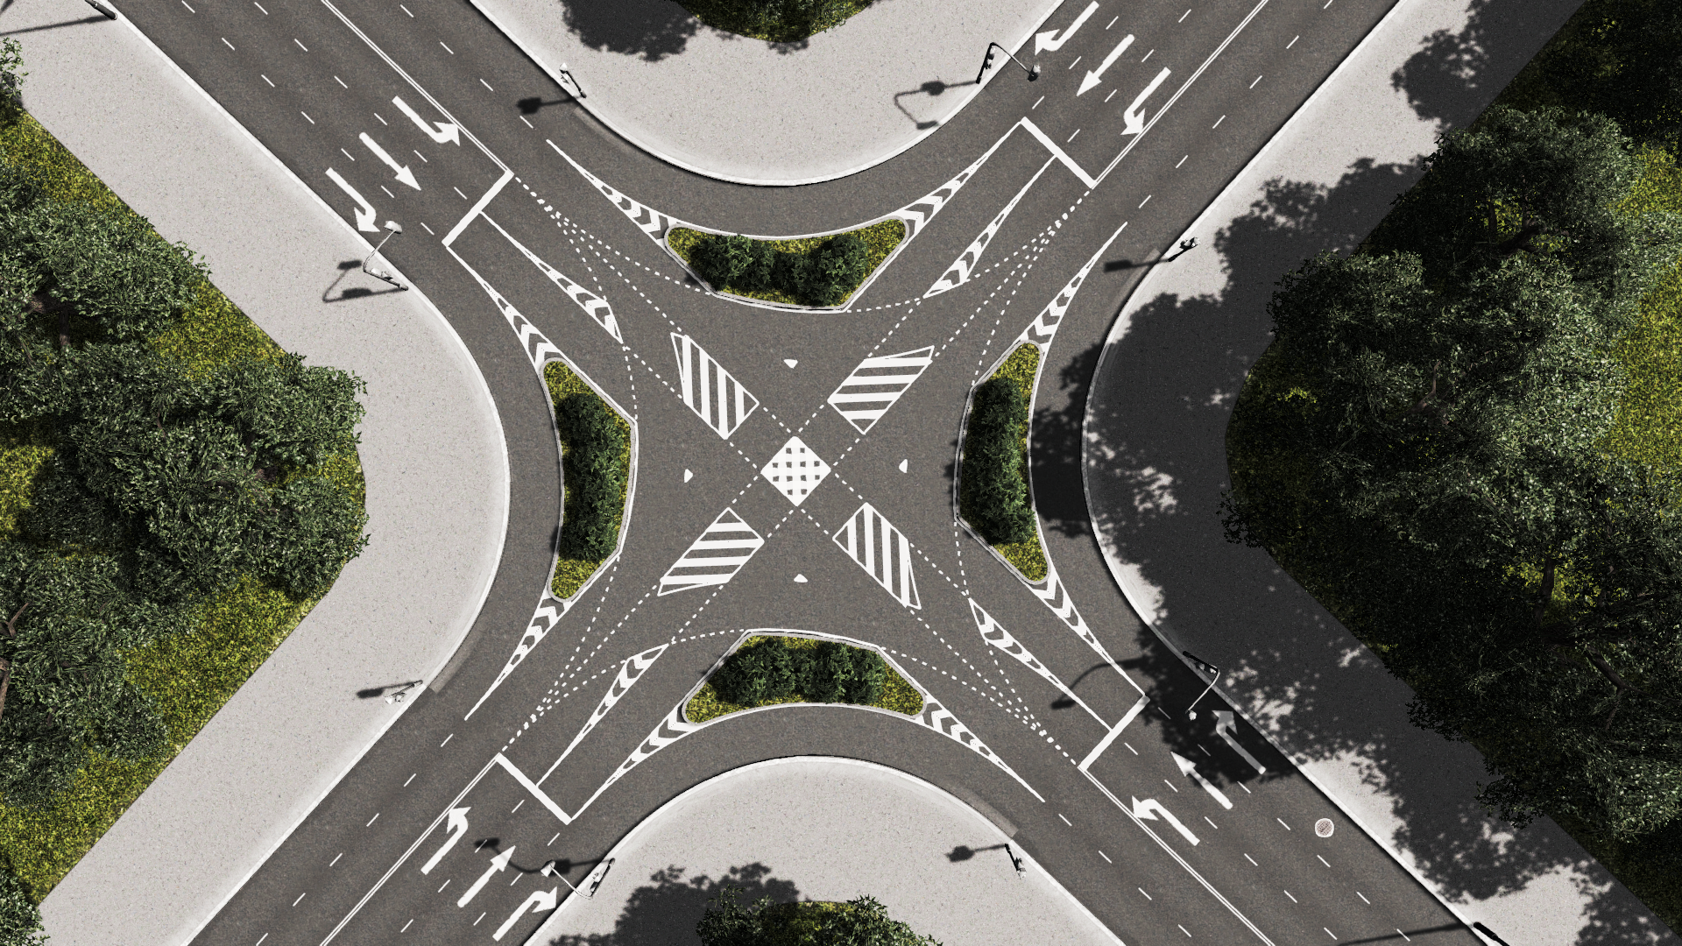
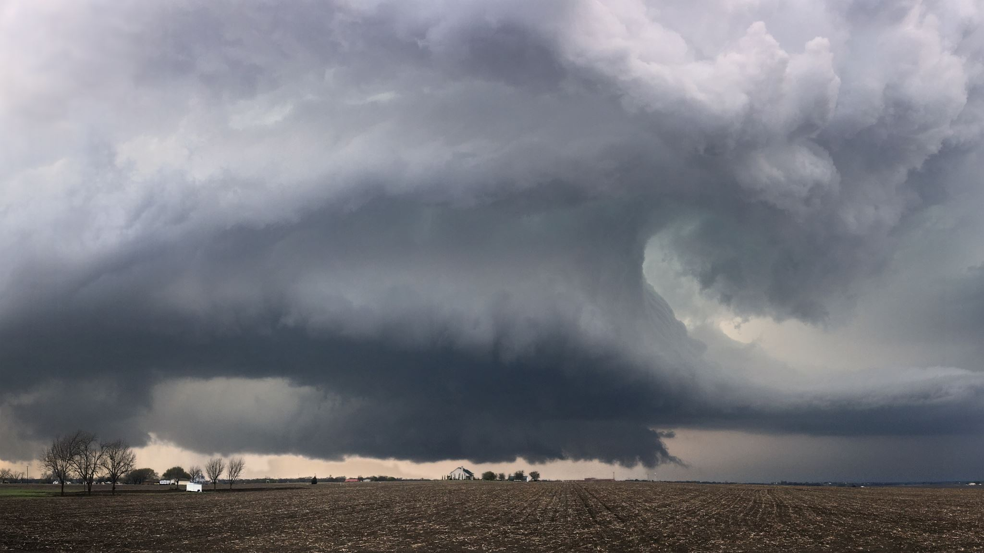
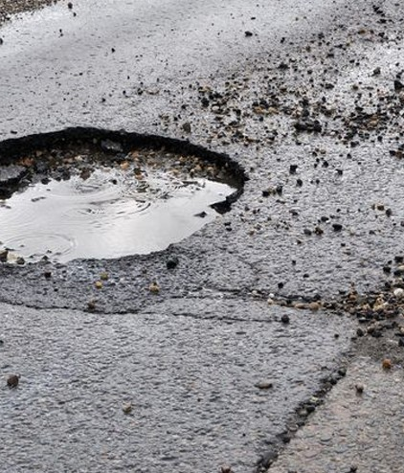
Overall Insights
Weather & Crash Type:
Clear weather is the most common condition for crashes, accounting for ~80% of both injury (~155K) and non-injury (~190K) crashes.
Rain is the second-highest contributor: ~28K injury crashes (14%) and ~43K non-injury (18%)
Lighting Conditions:
Daylight is associated with the most crashes (~125K injury; ~175K non-injury), likely due to higher traffic volumes during the day.
Street-lit darkness still contributes significantly (~60K injury, ~55K non-injury)
Road Defects:
Worn surfaces are the biggest contributor to crashes.
Ruts and holes are the second greatest contributors to accidents.
Fatal Crashes by Time of Day:
55.7% of fatal crashes happen during the day, challenging the myth that most fatal crashes occur at night.
Night crashes (44.3%), maybe due to poor visibility.
Trafficway Type and Fatal Injuries:
Four-way intersections (37.9%) and divided roads w/ no median barrier (29.3%) are the most fatal trafficway types.
Notes:
Tom/Sharon

Slide 15

Recommendations
Road Agencies:
Prioritize Road Maintenance - before High-Traffic Seasons
Ensure ample streetlights exist and are working -especially during winter months
Police:
Possibly increase standby during winter months
Policy Makers:
Consider implementing required driving courses pertaining to tackling various weather conditions
Reassess intersection safety — consider improving signage, adjusting signal timing, or converting to roundabouts to reduce conflict points.
Prioritize median improvements, such as installing raised barriers or rumble strips to prevent vehicles from entering opposing lanes.
Notes:
Tom/Sharon

Slide 16
Recommendations
Leverage real-time dashboards for operational and infrastructure decisions
Drivers & Learners
Master high-risk scenarios (signalized/uncontrolled intersections, end-of-week commutes)
Reduce crash risk → lower insurance premiums & increased peace of mind
Training Providers
Offer a premium, data-backed curriculum
Boost enrolments & partnerships; showcase “Safety First” outcomes
Communities
Targeted workshops & campaigns cut local crash rates and costs
Empower residents to prevent the most frequent accidents
Policy Makers
Use crash analytics to guide legislation & funding toward high-impact training
Monitor clear metrics to ensure public-sector ROI
Road Authorities
Apply insights in adaptive signal timing and intersection audits
Notes:
Aubrey

Slide 17
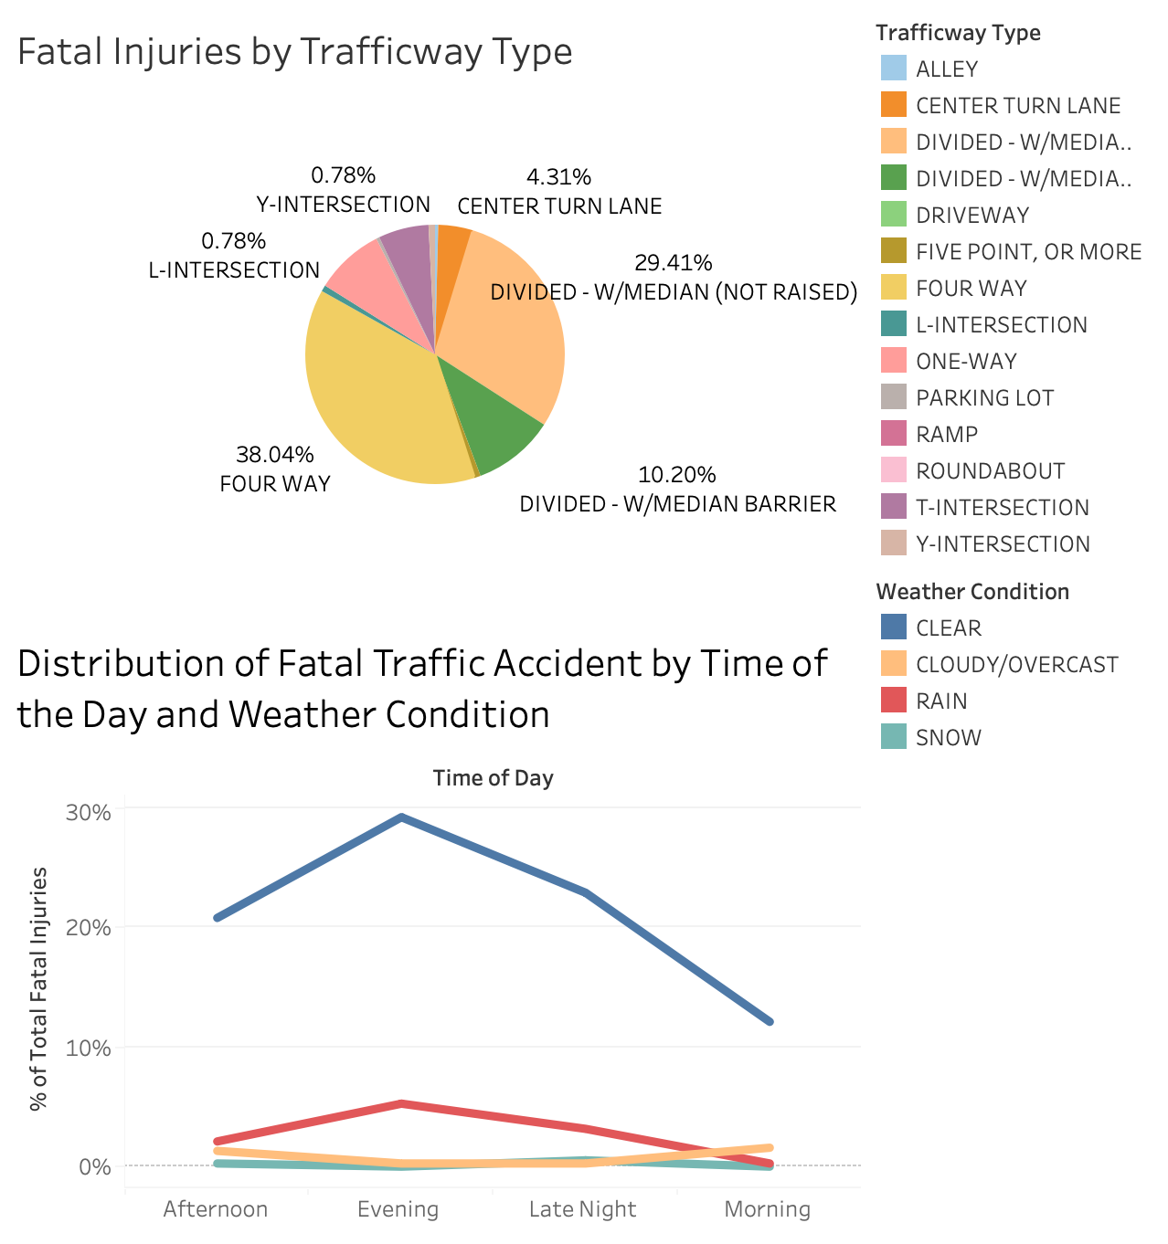
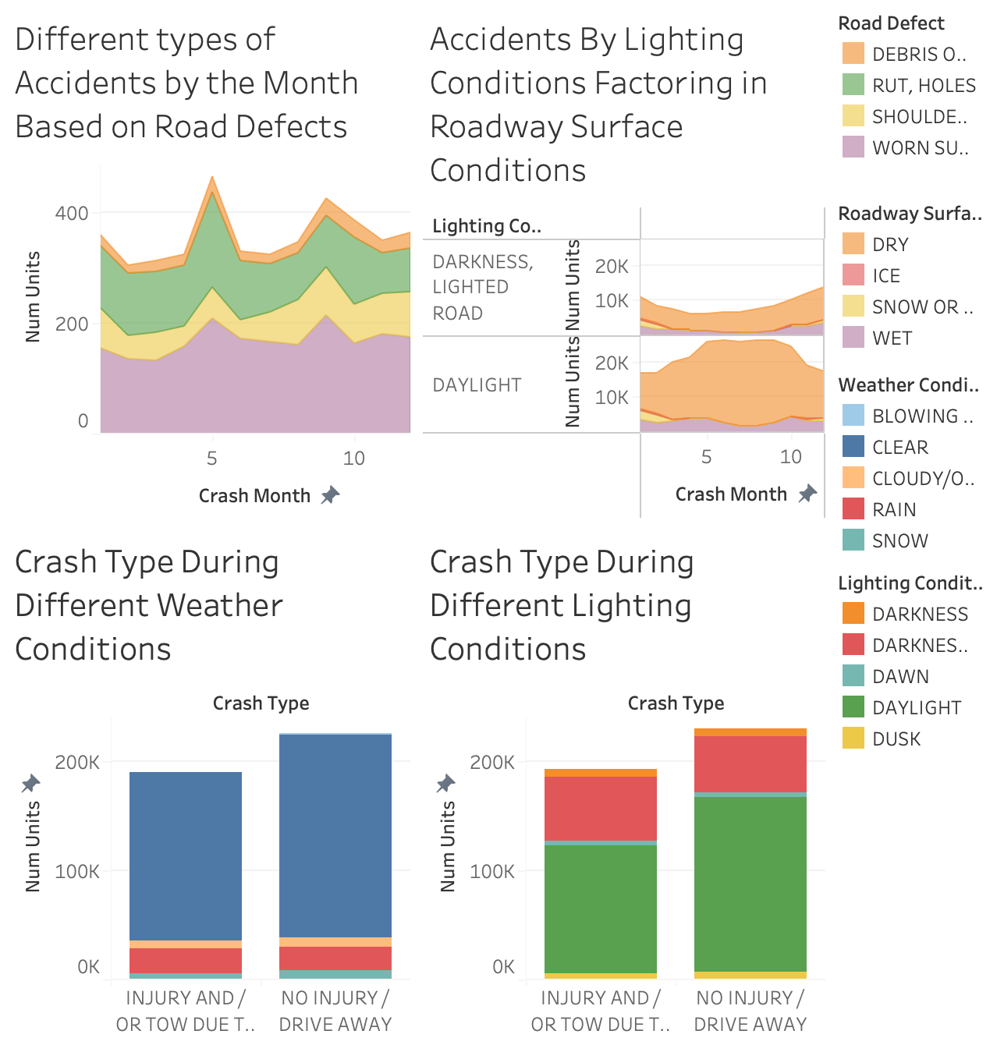
Dashboard for Stakeholders

